Slide 1
Science SOL 5.4 Matter

Slide 2
What is matter?
Matter is ANYTHING that takes up space and has mass.
Matter has tiny particles called atoms and molecules. They are too small to be seen with the human eye.

Slide 3
3 States of Matter:
Solids
Liquids
Gases

Slide 4
Solids
Have a definite shape and a fixed volume
Tightly packed molecules that are arranged in a regular pattern
Molecules vibrate in a fixed position
Example: rocks, ice

Slide 5
What the molecules of a solid look like:
Draw the molecules inside
the circle to represent
a solid.

Slide 6
Liquids
Have no definite shape
Molecules are farther apart than a solid and are not in any particular pattern or order
Molecules move and slide over each other
Examples: lemonade, water

Slide 7
What the molecules of a liquid look like:

Slide 8
Gases
Have no definite shape
It will take the shape of the container and will spread out to fill it
Molecules are very far apart
Molecules that move about quickly and freely
Examples: air, water vapor

Slide 9
What the molecules of a gas look like:

Slide 10
Changing States of Matter
For matter to change from one state to another (ex. Liquid to solid, gas to liquid) a change in temperature must happen
When temperature increases, a liquid can change to a gas, a solid can change to a liquid (ex. Liquid water changing to water vapor)
When temperature decreases, a liquid can change to a solid, a gas can change to a liquid (ex. Liquid water changing to ice)

Slide 11
Changing States of Matter
Freezing and boiling points of water:
Water freezes at 0 degrees Celsius
Water freezes at 32 degrees Fahrenheit
Water boils at 100 degrees Celsius
Water boils at 212 degrees Fahrenheit

Slide 12
Properties of Matter
There are 2 properties of matter:
Physical properties
Chemical properties

Slide 13
Physical Properties
Physical properties are things like:
Smell
Color
Taste
State

Slide 14
Chemical Properties
Chemical properties are how one type of matter reacts with another type of matter

Slide 15
Changing Matter
Matter can change in 2 ways:
Physical Change
Chemical Change

Slide 16
Physical Change
A physical change changes what an object looks like but does not change what it is made of.
Example: Cutting a piece of paper will make it smaller but it is still paper.

Slide 17
Chemical Change
A chemical change is a change that forms a new substance with new properties
Example: Burning a piece of wood creates smoke and ash. It is no longer a piece of wood after it is burned.

Slide 18
Measuring Matter
There are 2 ways to measure matter:
Volume
Mass

Slide 19
Measuring Volume
Volume is the amount of space that something takes up.
To find the volume of a solid rectangular object, you must multiply the length x width x height.
To find the volume of a liquid, you must use a graduated cylinder, measuring cup, etc.
To find the volume of an irregular object, you can place water in a graduated cylinder, measure the water level, add the object, re-measure the water level, then subtract the 2 amounts.
Common units used to measure volume: in³ (inches cubed or cubic inches, mL (milliliters)

Slide 20
Measuring Volume of a Solid, Rectangular Object
Find the Volume of the solid rectangular object:
Length: 4 in.
Width: 2 in.
Height: 3 in.
Length x Width X Height
4 in. x 2 in. x 3 in. = 24 in.³ (pronounced 24 inches cubed)
You must ALWAYS show your units!!!!

Slide 21
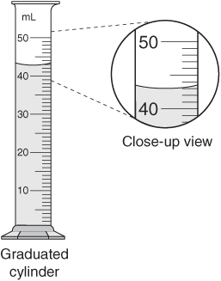
Measuring Volume of a Liquid
Find the Volume of the liquid inside the graduated cylinder:
You must read from the bottom of the
water line, called the meniscus.
Also, you must count the lines between
the numbers to see what the value of
each line is.
Answer: 43 mL (don’t forget units!)

Slide 22
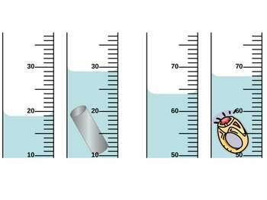
Measuring Volume of an Irregular Object
Find the volume of the irregularly shaped object:
You must first measure the water level, then add the irregular object, re-measure the water level, then subtract.
Object 1: 29 mL – 19 mL = 10 mL
Object 2: 68 mL – 64 mL = 4 mL

Slide 23
Measuring Mass
Mass is the amount of matter in an object.
Mass is not weight. Weight is the measure of the pull of gravity on an object. Weight can change, mass can not.
Example: You will weigh 1/6 less on the moon than you do on Earth. You body’s mass did not change, the weight did due to the gravitation pull.
Calculate your weight on the moon:
___________ pounds divided by 6 = _______ pounds

Slide 24
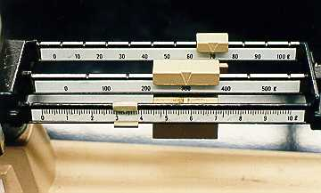
Measuring Mass
To measure mass, you must use a balance scale and add the weights on the beams of the scale.
Common units used to measure mass: grams, kilograms, ounces, or pounds
Measure the mass of the scale:
Mass = 300 g + 70 g + 3.3 g =
373.3 g

Slide 25
Density
Density is the amount of mass a substance has.
A rock will sink to the bottom of a pool because it’s density is greater than water.
A boat can float on water because it’s density is less than water.
Items can have the same volume, but have different densities.
For example, a pillow case filled with feathers is less dense that the same size pillow case filled with rocks. The volume is the same, the density is different.

Slide 26
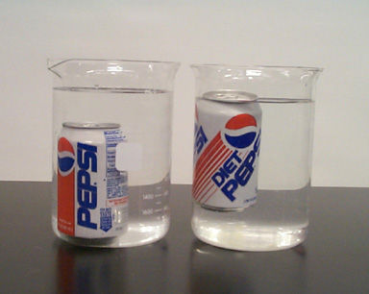
Density
If you look at the picture, you will see a regular can of Pepsi has more density than the same size can of Diet Pepsi.
The regular Pepsi has greater density than water.
The Diet Pepsi has less density than water.

Slide 27
Types of Particles in Matter
There are 4 types of particles in matter:
Atoms
Elements
Molecules
Compounds

Slide 28
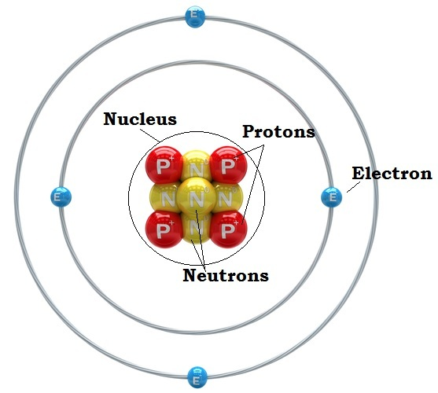
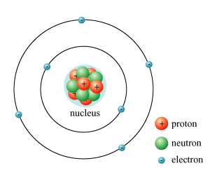
Atoms
All matter is made up of atoms.
Atoms can only be seen with a strong microscope.
All atoms have the same basic parts: protons, neutrons, & electrons.
Protons & neutrons form the nucleus.
Electrons orbit (move around) on the outside of the nucleus in the electron cloud.
Protons have a positive charge, electrons have a negative charge, neutrons have no charge.
The majority of the atom’s mass is in the nucleus.

Slide 29
Elements
One atom of an element is the smallest unit of an element that retains (keeps) the properties of that element.
Atoms combine to form elements.
Each element is given a name, such as, gold, hydrogen, & iron.
The element’s name and symbol identify it.
Most elements symbols have either 1 or 2 letters, some have 3. (ex. The atomic symbol for oxygen is O and for nickel is Ni.
The first letter of an atomic symbol is a capital letter and the 2nd and 3rd are lower case letters.
Every element has an atomic number which is the number of protons in the nucleus. For example, Oxygen has an atomic number of 8. This means there are 8 protons in the nucleus of every Oxygen atom.

Slide 30
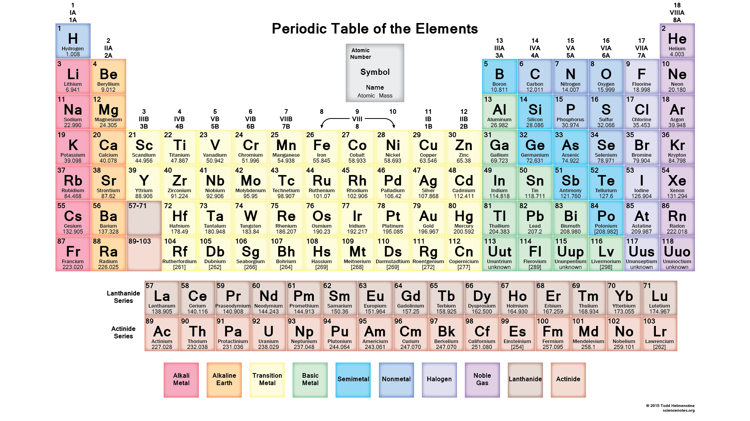
Periodic Table of Elements
All elements are arranged on the Periodic Table of Elements in order by their atomic number (number of protons in their nucleus.)
The periodic table also includes the element’s name, symbol, & atomic mass.

Slide 31
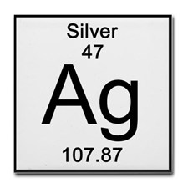
Periodic Table of Elements
Label the Periodic Table of Elements square for Silver. Name
Atomic #
Symbol
Atomic Mass
How many protons does the element of Silver have?

Slide 32
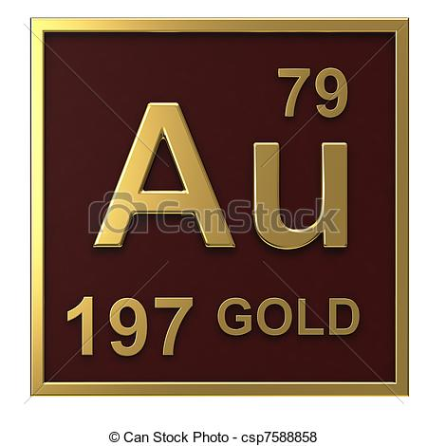
Figuring out the Number of Parts in an Atom
To figure out the number of protons of an atom, look at the atomic number on the periodic table (number of protons for Gold is 79.)
To figure out the number of electrons of an atom, look at the atomic number on the periodic table (it will be the same number as the protons, for Gold it will be 79.)
To figure out the number of neutrons of an atom, you must look at the atomic weight of the atom on the periodic table, and then subtract the atomic number.
For Gold, you will subtract 197-79=118. So the number of neutrons for Gold is 118.

Slide 33
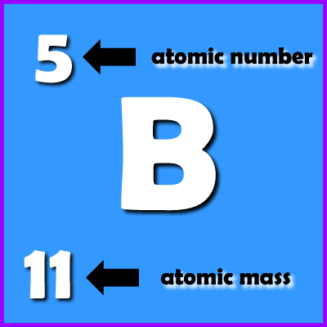
Drawing an Atom
Look at the element block for Boron on the Periodic Table.
Figure out the numbers for the protons, electrons, and neutrons for a Boron atom.
Protons = 5
Electrons = 5
Neutrons = 6 (11-5)

Slide 34
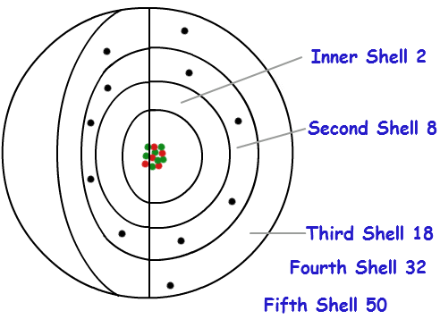
Drawing an Atom
Now that we have figured out the numbers of the particles in an atom, we can start to draw.
Always start with drawing the nucleus first.
Add the protons and neutrons inside the nucleus.
Add the electrons on the out side of the nucleus. The electrons are placed in the electron cloud and we use rings or circles to represent the electron cloud. Each ring has a specific amount of electrons a ring can hold. (See picture)

Slide 35
Drawing an Atom
Our atom of Boron should look something like this:
Protons: 5
Electrons: 5
Neutrons: 6
-
-
+
-
-
+
+
+
+
-

Slide 36
Molecules
Two or more atoms that are held together form a molecule.
Atoms of the same element can form a molecule or atoms from different elements can form a molecule
For example: 2 atoms of Oxygen can form an Oxygen molecule, O_{2.}
The 2 behind the O is called a subscript. It shows us how many atoms of each element are in the molecule.

Slide 37
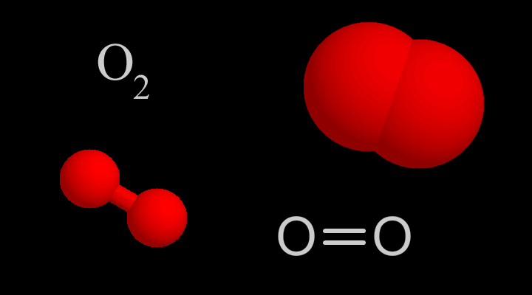
Molecules
Models of an Oxygen molecule:

Slide 38
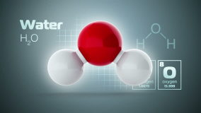
Compounds
Atoms of 2 or more elements join together to form a compound.
An Oxygen atom and 2 Hydrogen atoms can form a water molecule, H₂O.
H₂O is the formula for water. It shows us that there are 2 atoms of hydrogen and 1 atom of oxygen.
If there is only 1 atom of an element in a compound, we do NOT write a 1 for a subscript. We only write the symbol of the element.

Slide 39
Molecules & Compounds
Now draw a molecule of Oxygen and a compound of water:
O
O
O
Oxygen Molecule
H
H
Water Molecule

Slide 40
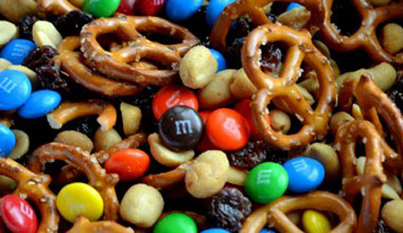
Mixture
A mixture is a combination of 2 or more substances that do not lose their identifying characteristics when combined
They are mixed, not joined chemically.
They can also be easily separated.
Examples: salad, milk and cereal, trail mix

Slide 41
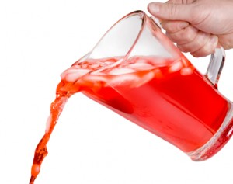
Solution
A solution is a mixture of molecules made by dissolving one substance into another substance.
All solutions are mixtures but not all mixtures are solutions.
It is possible to separate the 2 substances, but not very easily.
Examples: sugar dissolved in tea or Kool-Aid
The sugar is still there even though it is dissolved and you don’t see it.
In order to separate the solution, you would have to evaporate the liquid

Slide 42
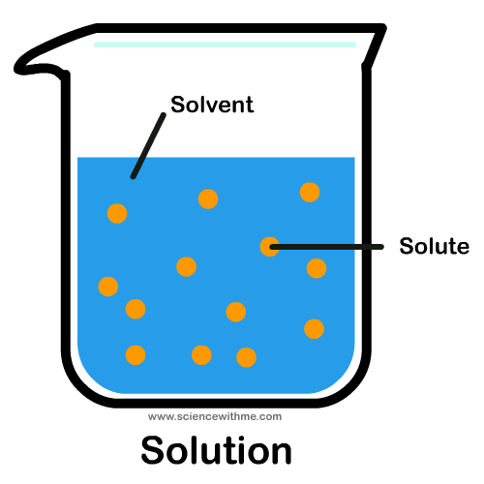
Solution
There are 2 parts to a solution: solutes & solvents.
A solute is a substance that dissolves in another substance. Ex. Sugar dissolving in water. The sugar is the solute
A solvent is a substance that dissolves a solute. Ex. Sugar dissolving in water. The water is the solvent.

Slide 43
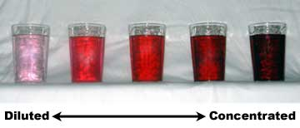
Solution
There are 2 kinds of solutions: diluted and concentrated.
A diluted solution is a weak solution that contains a small amount of solute and a large amount of solvent. Ex. Putting a tablespoon of sugar in a gallon of sweet tea.
A concentrated solution is a strong solution that contains a small amount of a solvent and a large amount of a solute. Ex. Putting 4 cups of sugar in a gallon of sweet tea.

Slide 44
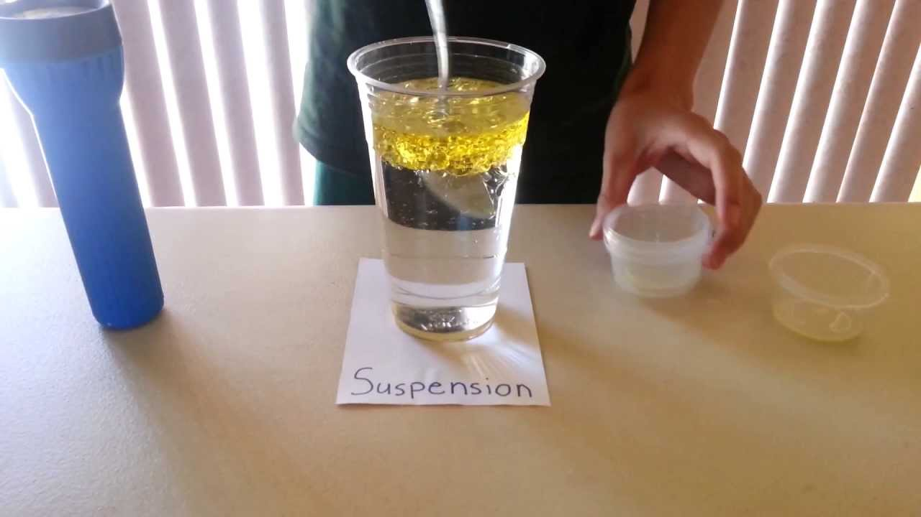
Suspension
A suspension is a mixture in which particles of a substance are scattered in another substance but NOT dissolved.
Examples: oil & vinegar salad dressing, orange juice, peanut butter, & milk.

